Slide 1
SCM-PROJECT
Team Details:
Anas Khan 2410990836
Anmol Singh Sidhu 2410990842
Aditya Patel 2410990819
Faculty Coordinator: Dr. Abhishek Khanna
:
Chitkara University Institute of Engineering and Technology,
Chitkara University, Punjab

Slide 2
Table of Contents
Introduction
Problem Statement
Technical Details
Key Features
Project Highlights
Bonus Feature(optional)
Conclusion
References/Links used

Slide 3
Introduction
"If you buy things you do not need, soon you will have to sell things you need." – Warren Buffett
Good evening everyone We are excited to present our Expense Tracker Website “Expense-Ease”, developed as part of our web development project.
In today's world, managing finances effectively has become crucial. With rising living standards and complex expenses, many struggle to control spending and stay within a budget.
Our app helps users monitor their expenses and provides insights into their financial habits, making budgeting easier and more efficient.

Slide 4
Problem Statement
This project introduces an innovative Expense Manager website that simplifies personal finance tracking for all users. In today’s complex financial world, many struggle to track spending and budget effectively. Our platform helps by offering a tool to easily record, categorize, and analyze expenses in real-time.
Key features include a user-friendly interface for easy navigation, even for non-tech users, and advanced analytics with interactive charts and graphs to visualize spending patterns and gain insights into financial habits.

Slide 5
Technical Details
HTML: HTML forms the backbone of our website, defining its structure. We used it to create and organize the layout of our expense tracker, including essential components like tables for listing expenses, forms for adding new entries, and buttons for user interaction. HTML tags helped create a clear hierarchy of elements, ensuring the site is functional and user-friendly.
CSS : CSS brings the visual design to life. By applying CSS, we were able to control the presentation of our website—such as colors, fonts, margins, and spacing—to make the tracker more visually appealing and easy to navigate. CSS was used to enhance the user experience by styling elements like buttons, input fields, and creating responsive designs to ensure that the site works well on different screen sizes and devices.

Slide 6
Key Features
Here are some key features that we could highlight on your expense tracker website:
1. User-Friendly Interface: An intuitive design that makes it easy for users to navigate and log their expenses quickly.
2. Expense Categorization: Allow users to categorize expenses (e.g., groceries, utilities, entertainment) for better organization and tracking.
3. Real-Time Analytics: Provide users with visual insights through charts and graphs that display their spending habits over time.
4. Recurring Expenses: Feature to manage and track recurring expenses, making it easier for users to plan their budgets.
5. Mobile Responsiveness: Ensure the website is accessible and fully functional on mobile devices, allowing users to track expenses on-the-go.

Slide 7
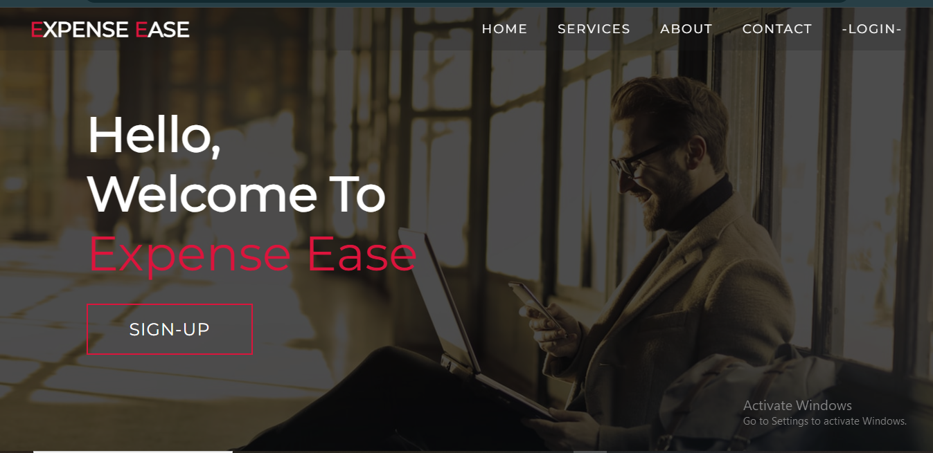
Project Highlights

Slide 8
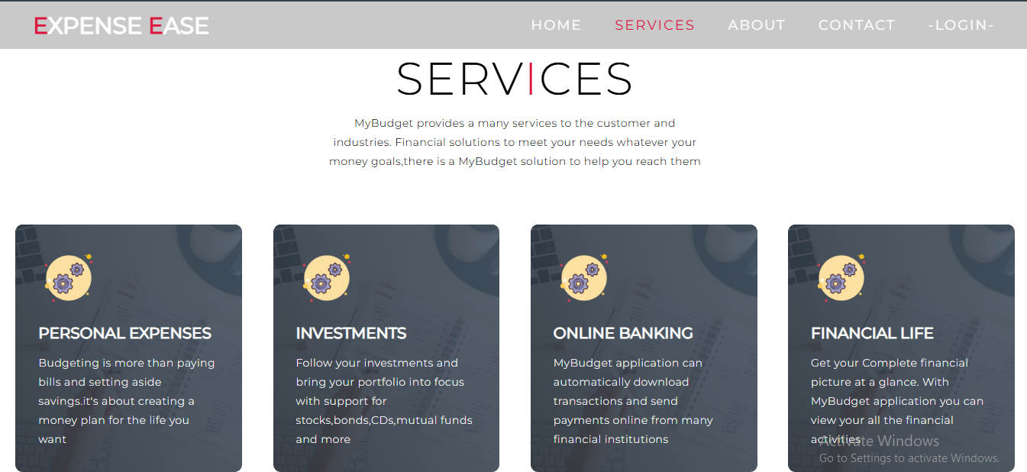
Project Highlights

Slide 9
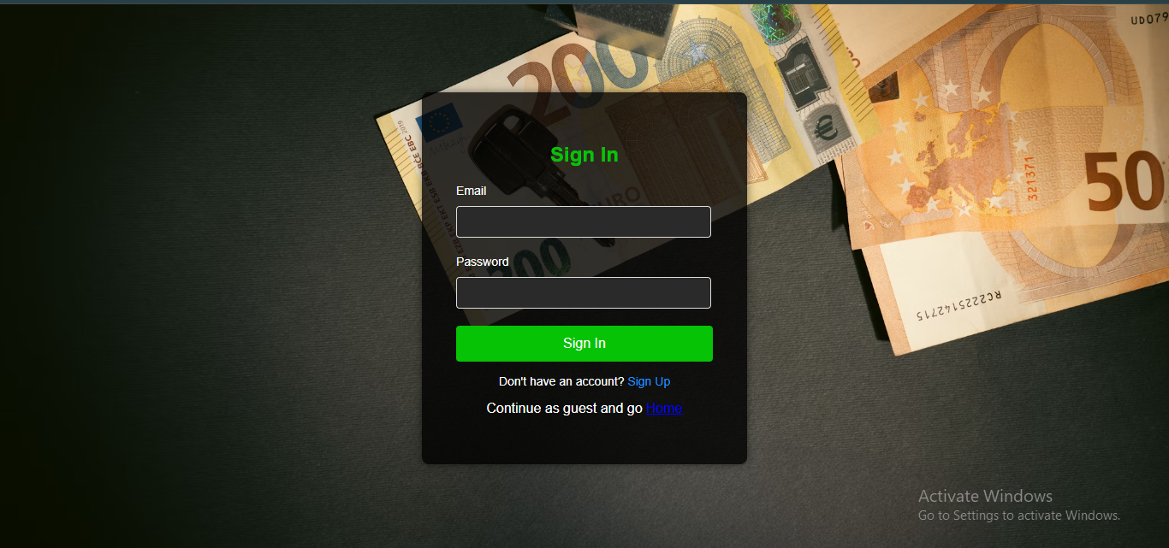
Project Highlights

Slide 10
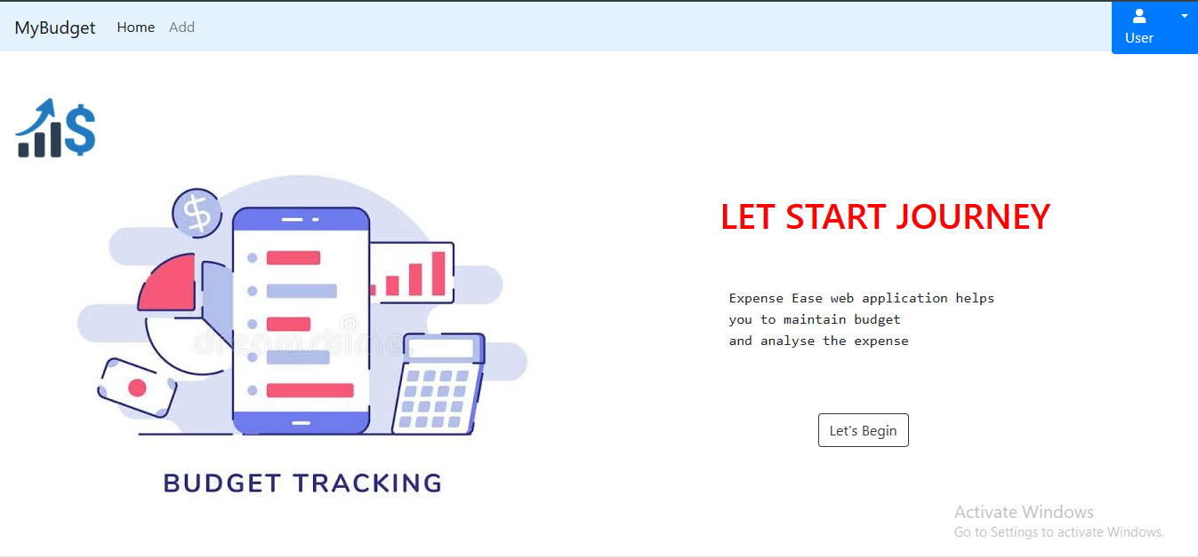
Project Highlights

Slide 11
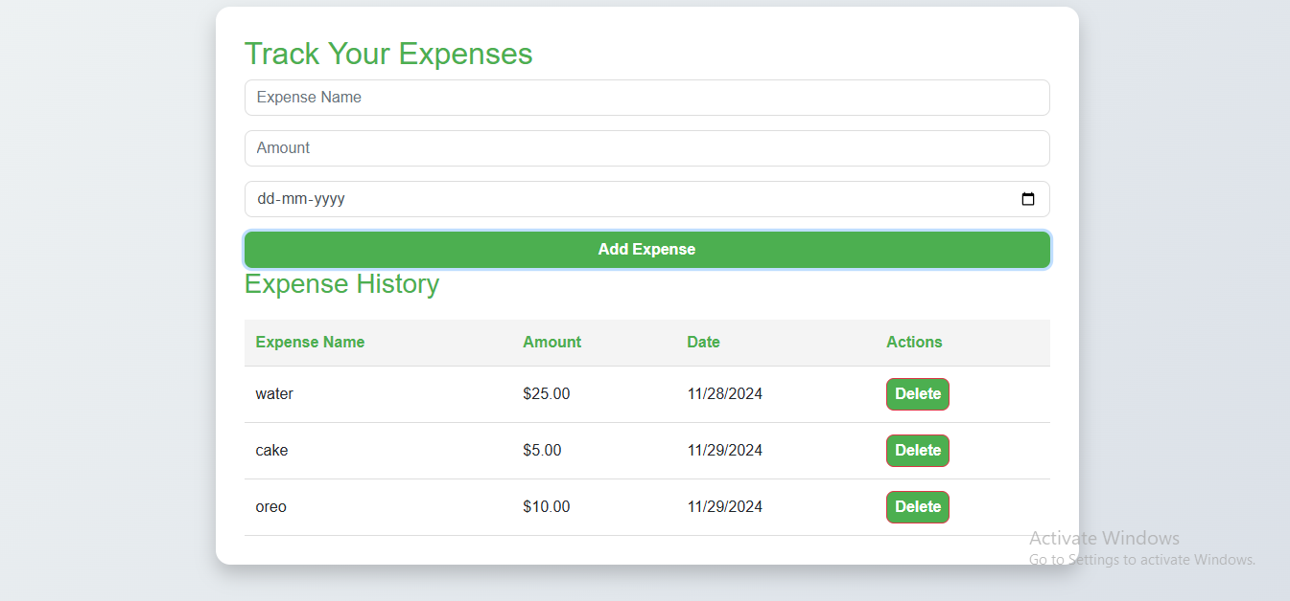
Project Highlights

Slide 12
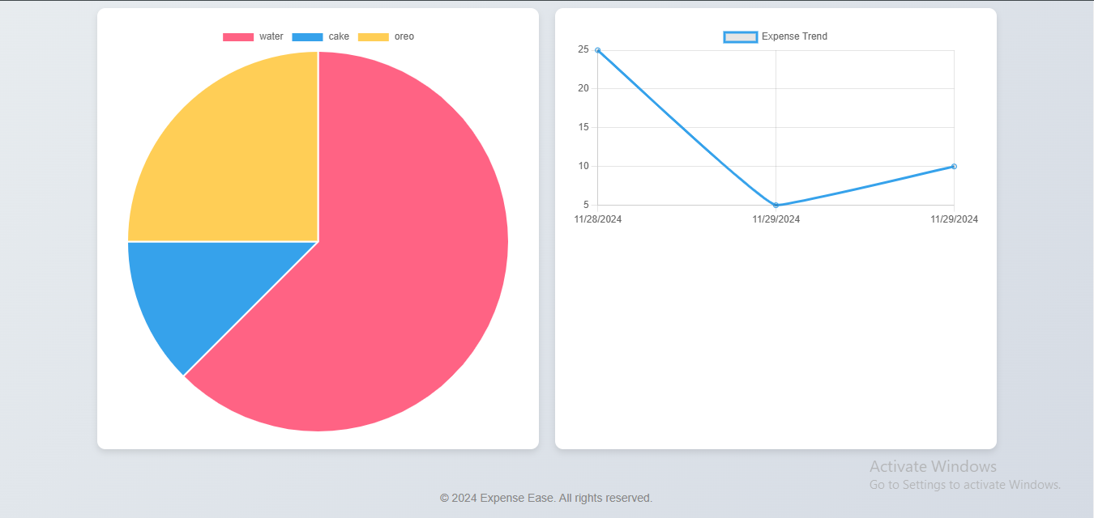
Project Highlights

Slide 13
Bonus Feature(optional)
Here are some of the bonus features of our project(yet to implement)-
The minimalistic design makes the website visually apealling and shows you content of your use.
Graphical representation helps you analyse your spendings

Slide 14
Conclusion
In conclusion, the expense tracker website, developed by us using HTML, CSS, and JavaScript, offers a seamless and interactive solution for managing personal finances. By providing a user-friendly interface and real-time tracking capabilities, it enables users to monitor their spending, categorize expenses, and set budget goals effectively. This project not only simplifies financial management but also encourages better budgeting habits, helping users make informed decisions and achieve long-term financial stability.

Slide 15
References/Links used
Youtube
Geeks for geeks
Git-hub
W3 School
Bootstrap

Slide 16


